Slide 1
Sanctification Pt 2:
How to Become Who You Are in Christ

Slide 2
Recap:
I. Sanctification: Rooted in union w/Christ (1 Cor 1:30)
A. WSC 35 "…the work of God's free grace, whereby we are renewed in the whole man after the image of God, and are enabled more and more to die unto sin, and live unto righteousness."
B. Two aspects of sanctification
1. Definitive: At moment of spiritual rebirth, there is a decisive break w/enslaving power of sin.
2. Progressive: ongoing, progressive, lifetime work of God's Spirit begun in regeneration where we are enabled to die to sin and live for righteousness.
II. Summary: We are becoming who we are in Christ by the power of God's Spirit and grace.
Notes:
Packer: "…not…sin being eradicated…but of a divinely wrought character change freeing us from sinful habits and forming in us Christlike affections, dispositions, and virtues…Christians become increasingly Christlike as the moral profile of Jesus (the "fruit of the Spirit”) is progressively formed in them."

Slide 3
Eph 4 - 1 I therefore, a prisoner for the Lord, urge you to walk in a manner worthy of the calling to which you have been called, 2 with all humility and gentleness, with patience, bearing with one another in love, 3 eager to maintain the unity of the Spirit in the bond of peace…17 Now this I say and testify in the Lord, that you must no longer walk as the Gentiles do, in the futility of their minds. 18 They are darkened in their understanding, alienated from the life of God because of the ignorance that is in them, due to their hardness of heart. 19 They have become callous and have given themselves up to sensuality, greedy to practice every kind of impurity. 20 But that is not the way you learned Christ!—assuming that you have heard about him and were taught in him, as the truth is in Jesus, 22 to put off your old self, which belongs to your former manner of life and is corrupt through deceitful desires, 23 and to be renewed in the spirit of your minds, 24 and to put on the new self, created after the likeness of God in true righteousness and holiness.

Slide 4
Eph 5:1 Therefore be imitators of God, as beloved children. 2 And walk in love, as Christ loved us and gave himself up for us, a fragrant offering and sacrifice to God. 3 But sexual immorality and all impurity or covetousness must not even be named among you, as is proper among saints. 4 Let there be no filthiness nor foolish talk nor crude joking, which are out of place, but instead let there be thanksgiving. 5 For you may be sure of this, that everyone who is sexually immoral or impure, or who is covetous (that is, an idolater), has no inheritance in the kingdom of Christ and God. 6 Let no one deceive you with empty words, for because of these things the wrath of God comes upon the sons of disobedience. 7 Therefore do not become partners with them; 8 for at one time you were darkness, but now you are light in the Lord. Walk as children of light.

Slide 5
Key errors in how we "do" sanctification:
I. Activism and Quietism:
A. Activism: Self-righteous/sufficient/reliant activity * "Work out your salvation!" Example: Martha
B. Quietism: Inactive "let go and let God" passivity
* "Wait for God to work in you to will/do…"
Example: Mary (wrongly applied)
Packer: "…regenerate persons, alive to God and freed from sin's dominion, are required to exert themselves in sustained obedience. God's method of sanctification is neither activism (self-reliant activity) nor apathy (God-reliant passivity), but God-dependent effort (2 Cor. 7: 1; Phil. 3:10-14; Heb. 12:14).
c. Legalism: create rules to justify selves
d. Antinomianism: law has no relevance.
Notes:
Activism: Purely performance and outward focused.
Quietism: purely inward focused, inactivity, contemplation.

Slide 6
II. Legalism and Antinomianism:
A. Legalism: use God's law and/or our own rules and performance to justify ourselves before God and man.
B. Antinomianism: Under the Gospel, believers have no obligation to obey God's moral law.
C. Both misuse/misunderstand Law and Gospel.
III. Summary:
Activism/Legalism: Self-righteous/reliant performance driven
Quietism/Antinomianism: No striving for holiness/License
Notes:
Legalism: Downplays rigors of God's law and indwelling sin in man.
Activism/Legalism: purely concerned with outward displays of righteousness/not doing technicolor sin/ignores internal sins of the heart (lust, bitterness, envy, jealousy, hatred) and downplays behaviors/attititudes that are not considered scandalous: anger, snarkiness (speaking in a sarcastic, irritable tone), abrasiveness, coarse joking.
Quietism/Antinominianism similar! Downplays sin, exalts its own perceived spiritual.
Both exalt themselves and are self righteous in their own way.

Slide 7
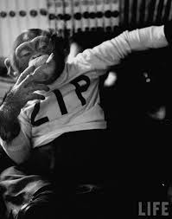
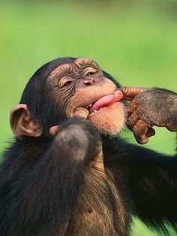
The Result of Quietism/Antinomianism
“Yeah, God loves me just the way I am, and Jesus paid it all, so why change!"
“Yo God, dude, thanks for all that grace. Whew! I'm gonna kick back now till I get to heaven!”

Slide 8
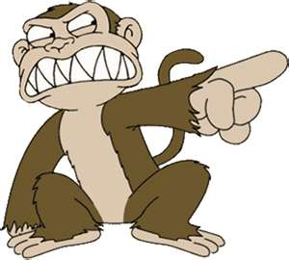
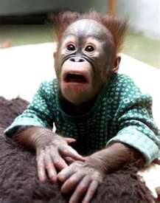
The Result of Activism/Legalism:
Guilt ridden, bewildered
“Lord, I thank you that I’m not like that sinner over there!”
“I’m so unworthy!" "God doesn’t love me!”

Slide 9
The Gospel Gap
I. Christians understand how the Gospel relates to past forgiveness, and how our future hope is in Christ. But, we tend to “understate or misunderstand the “now” benefits of the work of Christ."
II. We think the Gospel is for unbelievers only:
A. Reduce to justification instead of Union w/Christ.
B. Bible is just a rule book for living.
C. We will in the "Gospel Gap" with many things:

Slide 10
*Formalism: Do stuff, but little/no impact on heart.
*Legalism: Christianity a list of do’s/don’ts where we judge our spirituality and everyone else’s based on compliance.
*Mysticism: Experience (not theology/character)
*Activism: Get involved with causes against some evil “out there."
*Biblicism: Theology, but neglect communion/character
*Psycholog-ism: Christ is more a therapist than He is a Savior.
*Social-ism: fellowship and community replace Christ.
* Most common: Religious works:
I go to church; I read my Bible; I teach bible study; I do _____
Notes:
Element of truth in all of these, but problem is when they are divorced from Christ, and one thing becomes the focus.

Slide 11
III. The Gospel not just about getting heaven; but every day life:
Lane/Tripp: "What difference does the gospel make in the here and now? How does it help me as a father, a husband, a worker, and a member of the body of Christ? How does it help me respond to difficulty and make decisions? How does it give me meaning, purpose, and identity? How does it motivate my ministry to others?”
A. Indicative/Imperative
B. The Structure of Ephesians: since this, then do this

Slide 12
Fill The Gospel Gap With the Gospel!
I must have a “Gospel-driven” sanctification, where I preach the Gospel to myself everyday, which declares to me who I am in union with Christ (forgiven by God and righteous in His sight because of the imputed
righteousness of Christ), and how I am therefore to live in Christ by the power of the Holy Spirit. This means that the promises of the Gospel must be daily impressed upon my heart—that I rest upon the person, work, and power of Christ, striving and laboring to become who I already am in Christ by grace alone through faith alone in and by Christ alone.
Notes:
Basically, we want to live out of our union with Christ. Recognizing who we are in Christ, and what we are becoming in and by Christ.

Slide 13
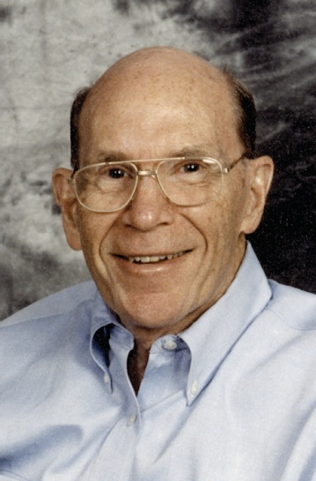
Jerry Bridges: “Christians need to hear the gospel all of their lives because it is the gospel that continues to remind us that our day-to-day acceptance with the Father is not based on what we do for God but upon what Christ did for us in his sinless life and sin-bearing death.
"…we stand before God today as righteous as we ever will be…because he has clothed us with the righteousness of his Son. Therefore, I don't have to perform to be accepted by God. Now I am free to obey him and serve him because I am already accepted in Christ…My driving motivation now is not guilt but gratitude."

Slide 14
The Result of Activism/Legalism:
Guilt ridden, bewildered
“Lord, I thank you that I’m not like that sinner over there!”
“I’m so unworthy!" "God doesn’t love me!”
Notes:
The legalist/activist is concerned purely with outward performance and is blind to internal sin

Slide 15
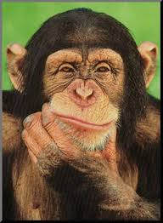
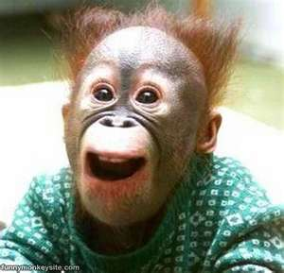
Gospel Driven Sanctification
Hey! I’m worse than I thought I was, but more loved in Christ that I ever dared imagine, and so are you my little furry friend! Now I can love and serve Him without fear!
For real?! You mean my struggles are normal! I love Jesus, and I love you! Hey, do you have any bananas we give to others (and maybe keep 2 for us!
Notes:
Ferguson: “Christians who are most focused on their own spirituality may give the impression of being the most spiritual ... but from the NT’s point of view, those who have almost forgotten about their own spirituality because their focus is so exclusively on their union with Jesus Christ and what He has accomplished are those who are growing and exhibiting fruitfulness.”
Essentially, we are saying that we live out of our union with Christ

Slide 16
How do we do it?
I. Prayer
II. Word
A. Personal/corporate reading (Ps 1; Col 3:16)
B. Three-fold use of law
1. 1st function: show God's holiness/our own sinfulness, to drive us to repent/faith in Christ.
2. 2d function: restrain evil in world.
3. 3d function: Rule of life that tells us what pleases God and how to live in His kingdom.
III. Church/Fellowship: talent, time, treasure.
IV. Sacrament
Notes:
Col 3:16 Let the word of Christ dwell in you richly, teaching and admonishing one another in all wisdom, singing psalms and hymns and spiritual songs, with thankfulness in your hearts to God.
Calvin says both 1st and 2d uses are schoolmaster to drive us to Christ. 1st use: Moral law comes crashing down on those who try to justify themselves by their works. In restraining sense, it functions to drive them to Christ, especially those who take excessive pride their civic virtue.
we look to Christ, not to the law. We do not look to the law, any law whatever you call it apart from Christ. Christ is the lens through we view everything. The life we live we live by faith. Faith moves us to obedience. It is only in that sense that the law functions as a guide.

Slide 17
God has given us spiritual disciplines to help us grow. However, we never outgrow the need for God's grace. The same way we began the Christian life is the same way we grow in it: by grace alone, through faith/repentance alone, in and by Christ alone. We engage the spiritual disciplines not in our own strength, or in trusting in them to grow us, but with an attitude of faith (relying on God) and repentance (turning from our sin).

Slide 18
Life Scenarios
Notes:
What are some of the character traits that are revealed here? Service, humility, love

Slide 19
Personal Purity
What measures do you take to keep your self from sexual immorality? Why is this important?
Notes:
What are some of the character traits that are revealed here? Service, humility, love

Slide 20
Home
You’re terribly busy laying on the couch and channel surfing. While at the height of this exciting, life changing activity, your spouse calls down to you from upstairs, “honey, can you go to the basement and bring me up a towel and a pair of pants?” How do you react?
A. You call up, “Why don’t you do it! I’m busy!”
B. Roll your eyes, grumble, and go and do it
C. You joyfully view it as yet one more opportunity to love your wife as Christ loved the church, and you respond, “Sure thing, love of my life!” And you go and do it.
Notes:
What are some of the character traits that are revealed here? Service, humility, love

Slide 21
Work
Your boss notices that you spend a lot of time on personal calls/email/facebook. She had the audacity to then ask you if you wouldn’t mind curbing that activity, and focusing…gasp… more on your work. How do you react?
A. You send a “personal” email to your friends and post on facebook about what a horrible boss you have b/c she had the nerve to ASK you to limit the personal stuff.
B. You tell your boss where she can go.
C. You recognize that you have been stealing time, ask for forgiveness, and repent.

Slide 22
Church
You love your cup of java in the morning, but notice that the church only has powdered creamer instead of liquid creamer. How do you react?
A. You get irritated and complain to everyone.
B. You email the pastor to tell him what a travesty it is b/c the “visitors” won’t feel welcome.
C. You realize that it has been granted to us both to belief and to suffer for the Lord, so you thank God for the trial, and decide to buy liquid creamer to donate to the church.
Notes:
What are some of the character traits that are revealed here? Service, humility, love

Slide 23
Church
You get into a dispute with another church member. You attempt to reconcile, but he refuses to listen, and runs you down to others and mischaracterizes you and the dispute. How do you react?
Notes:
What are some of the character traits that are revealed here? Service, humility, love

Slide 24
Cheer up! I have some GREAT NEWS for you:
You’re worse than you think you are, but more loved in Christ than you ever dared imagine. And, He is working in us to conform us to His image!
Notes:
This is not a sprint though! It is a marathon. Sometimes it may seem we are not being conformed…but we are.

Slide 25
The Ultimate Application
1. Confront ourselves daily with the Gospel
2. Daily Faith and Repentance
3. Make use of God’s means for growth

