Slide 1
The 5 Points of Calvinism Pt 2:
The Sovereignty of God

Slide 2
T – Total Depravity: Man’s whole nature is corrupted by sin so that He cannot do any spiritual good.
U – Unconditional Election: Before time, God chose many sinners to save on the basis of His grace and mercy alone, not on anything good or foreseen in them.
L – Limited Atonement: Christ atoned for the sins of the elect, securing and guaranteeing their salvation.
I – Irresistible Grace: God raises spiritually dead sinners to spiritual life when He wants to enable them to believe.
P – Perseverance of the Saints: The elect must and will persevere to the end, being preserved by God's power.
Notes:
T – Classic Arminians would seem to embrace this doctrine as well. However, they add the concept of prevenient grace, which puts all men without exception in a kind of neutral state, with the ability to use their free will to choose or reject the things of God.

Slide 3
Intro
1. Three foundations of Calvinism (Biblical Christianity):
- The Absolute Sovereignty of God
- The Total Depravity of Man
- The Complete Sufficiency of Christ and His Word
Notes:
- Take from Jason Van Bemmell: http://www.monergism.com/thethreshold/sdg/ThreePillars.pdf
- Absolute – some people say God has chosen to limit His sovereignty because they cannot reconcile absolute sovereignty with human responsibility and freedom. But limited sovereignty is no sovereignty. Either God is in control of all things, including the choices of men, or He is not. And if He is not, then He is not sovereign over history, because history is played out through the choices of human beings.
- Total Depravity: sin has radically corrupted the entirety of man's nature, to include his will, so that he cannot choose the things of God.
- The complete sufficiency of Christ – Christ's work alone secures and quarantees the salvation of all He died for.
Complete Sufficiency: nothing is to be added to the perfect work of Christ to bring about salvation. His work alone is sufficient in and of itself to secure and guarantee the salvation of all those He came to save.
Note: those 3 foundations correspond to the Gospel outline we have referenced throughout the class:
- God: Holy/sovereign Creator; must worship Him alone.
- Man: rebelled against God; is condemned before Him.
- Christ: died for sins/rose from dead; believers forgiven.
- Response: must turn from sins and trust Christ alone.

Slide 4
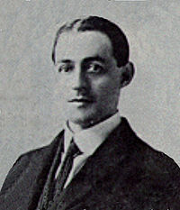
2. A.W. Pink: "Who is regulating affairs on this earth today—God, or the Devil? … What are the conceptions formed by those who hear even those preachers who are counted as "orthodox"? …Is it
not that a disappointed God is the One whom Christians believe in…a God who is filled with benevolent intentions, yet unable to carry them out?…What saith the Scriptures?...They affirm…that God is on the throne of the universe…that He is directing all things "after the counsel of His own will." Only two alternatives are possible: God must either rule, or be ruled; sway, or be swayed; accomplish His own will, or be thwarted by His creatures…

Slide 5
...Our first postulate is that because God is God…His great concern is the accomplishment of His own pleasure and the promotion of His own glory; that He is…Sovereign of the universe.”
I. Definition: God's rule and reign—His His complete control over, and direction and governing of—everything and everyone in heaven and on earth. In sum:
God does as He pleases, when He pleases, how He pleases, to whom pleases, in the time and manner He pleases to accomplish all He ordained before time.

Slide 6
II. Some Key Texts on God's Sovereignty
Gen 1:1 In the beginning, God created the heavens and the earth.
1Ch 29:11 Yours, O LORD, is the greatness and the power and the glory and the victory and the majesty, for all that is in the heavens and in the earth is yours. Yours is the kingdom, O LORD, and you are exalted as head above all.
Isa 14:27 For the LORD of hosts has purposed, and who will annul it? His hand is stretched out, and who will turn it back?
Notes:
Gen 1 - The act of creation itself is a sovereign act of God, and if He created, surely He also must govern all that He creates.
1 Chron 29 – If man can thwart God's purposes, how can these things be said in any meaningful sense? If everything is God's, then He owns it all, and He will do with it as He pleases and direct it to His own ends and accomplish all that He purposes with it.
Isa 14 – From the perspective of God's eternal decree and purpose, it is dependent upon man "letting God" do what He wants with whomever He wants. It's a matter of God's power alone who will accomplish His purpose, not only despite whether or not man will let him, through the very ones (everyone else) who think they are thwarting His plans. Man is powerless to do other than what God has ordained.

Slide 7
Isa 40:17-28 …17 All the nations are as nothing before him, they are accounted by him as less than nothing and emptiness.…21 Do you not know? Do you not hear? Has it not been told you from the beginning? Have you not understood from the foundations of the earth? 22 It is he who sits above the circle of the earth, and its inhabitants are like grasshoppers; who stretches out the heavens like a curtain, and spreads them like a tent to dwell in; 23 who brings princes to nothing, and makes the rulers of the earth as emptiness. 24 Scarcely are they planted, scarcely sown, scarcely has their stem taken root in the earth, when he blows on them, and they wither, and the tempest carries them off like stubble.

Slide 8
…25 To whom then will you compare me, that I should be like him? says the Holy One. 26 Lift up your eyes on high and see: who created these? He who brings out their host by number, calling them all by name, by the greatness of his might, and because he is strong in power not one is missing… 28 Have you not known? Have you not heard? The LORD is the everlasting God, the Creator of the ends of the earth. He does not faint or grow weary; his understanding is unsearchable.

Slide 9
Isa 43:12-13 …You are my witnesses, declares the LORD, "that I am God. Yes, and from ancient days I am he. No one can deliver out of my hand. When I act, who can reverse it?
Isaiah 45:6-7 …I am the LORD, and there is no other. I form the light and create darkness, I bring well being and create calamity; I, the LORD, do all these things.
Isaiah 46:9-10 …I am God, and there is none like me. I make known the end from the beginning, from ancient times, what is still to come. I say: My purpose will stand, and I will do all that I please.”
Notes:
Isa 43 - There is no power in heaven, earth, or hell that can stop the Lord. Illustration: An infant may cry but can’t prevent the parent from putting him in the crib. Likewise, man and demons may rage against the Lord, but they can only do what He permits them to do.
Isa 45 - Key principle: anything that happens—whether good or bad—is ultimately under the sovereign control and direction of the Lord.
Isa 46 - One of the proofs of the utter uniqueness and superiority of the Lord is predictive prophecy: the Lord alone is able to say with exact precision what will certainly happen before it happens! And the Lord roots this predictive prophecy to His eternal purpose. That which the Lord decreed before time even began will happen in the exact time, place, and manner that He has determined, and His purpose, not the purpose of men or demons, will stand.

Slide 10
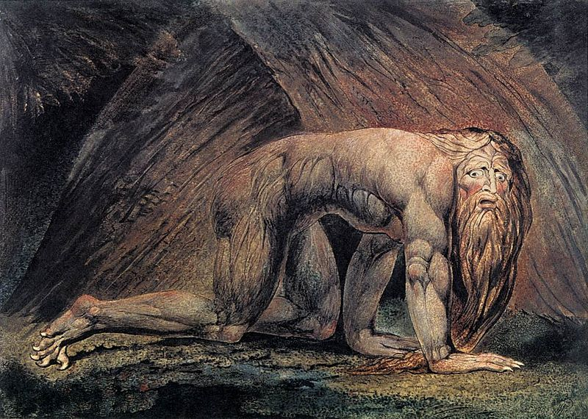
Lamentations 3:37-38 Who can speak and have it happen if the Lord has not decreed it? Is it not from the mouth of the Most High that both calamities and good things come?
Dan 4:34-35 …for his dominion is an ever-
lasting dominion, and his kingdom
endures from generation to generation;
35 all the inhabitants of the earth are
accounted as nothing, and he does according to his will among the host of heaven and among the inhabitants of the earth; and none can stay his hand or say to him, "What have you done?"
Notes:
Lamentations – greatest example: the crucifixion of Christ (Acts 2:23)

Slide 11
Rom 9:18-21 "So then he has mercy on whomever he wills, and he hardens whomever he wills. 19 You will say to me then, "Why does he still find fault? For who can resist his will?" 20 But who are you, O man, to answer back to God? Will what is molded say to its molder, "Why have you made me like this?" 9:21 Has the potter no right over the clay, to make out of the same lump one vessel for honorable use and another for dishonorable use?"
Eph 1:11 "In him we have obtained an inheritance, having been predestined according to the purpose of him who works all things according to the counsel of his will…"

Slide 12
II. God's Sovereignty Displayed
A. Entire universe and nature: Ps 103:19; Ps 135:6-7
B. Angels & Satan: Ps 103:20-21; Job 1:12
C. Nations: Ps 47:7-9; Dan 2:20-21; 4:34-35
D. Human beings: 1 Sam 2:6-7; Acts 17:26-27
E. Animals: Ps 104:21-30; 1 Ki 17:4-6
F. "Accidents": Pr 16:33; Luke 13:4
G. The free acts of men: Acts 2:22-23, 4:27-28
H. Sinful acts: Gen 50:20
I. Grace: God bestows His favor and salvation on whomever He desires according to His own purposes w/o regard to anything in man (Rom 9:11-21; Eph 1:3-6).

Slide 13
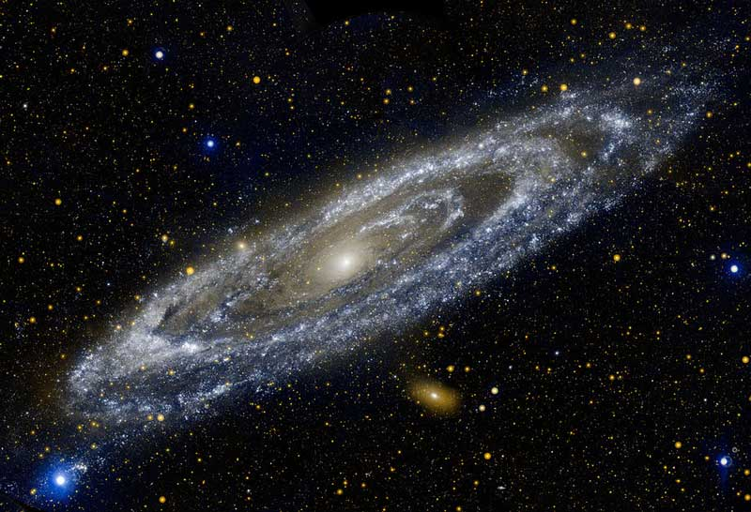
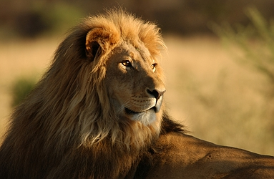
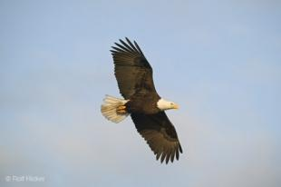
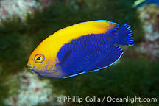
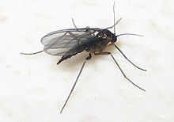
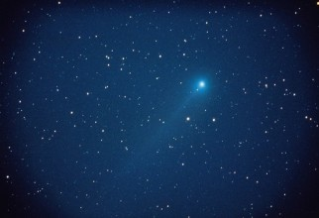
The Lord determines and controls the number and movement of galaxies, planets and stars; the animals of the land; the birds of the sky; the fish of the sea; and even the pesky and irritating gnat that flies in your ear.
He determines and controls the diversity, complexity, and movement of the microscopic universe of cells and bacteria, molecules and microbes, atoms and protons and electrons. He determines the precise number of feathers on a sparrow, and the precise time when that sparrow will fall to ground.

Slide 14
He determines the number of hairs on our head, and the circumstances of our lives and death: who are parents are, where we live, and our station in life: whether we’re rich, poor, black, white, a janitor or a politician. He determines the salvation of people, their growing in holiness.
God’s sovereignty is absolute and is displayed in every sphere of heaven and earth. There are no maverick molecules or autonomous atoms running around outside of the sovereign decree and direction of the Lord who governs all things according to the counsel of His will, "for His wise and just and good purposes.”

Slide 15
III. God's Sovereignty and Human Responsibility
A. Deut 29:29 The secret things belong to the LORD our God, but the things that are revealed belong to us and to our children forever, that we may do all the words of this law.
1. Will of decree: What God ordained to happen before time began. What God wills in this sense always happens.
2. Will of command: How God wants us to live. We constantly violate this will and are held accountable for doing so.
Notes:
3. God has determined what will happen, to include our sinful choices and acts, and God is working all of that according to the council of His will to bring out His good purposes. (Gen 50:20; Acts 2:23). Example: In God’s revealed will, He commands all men to repent; but in terms of God’s secret will, He has determined that all men will not repent, and He has also determined to bring some of them to repentance.

Slide 16
B. Man's Will and Responsibility
1. Man has free agency: power of personal decision.
2. Limited by God's decree and our nature.
a. We make choices consistent w/nature
b. God sovereignly overrules (and/or uses)
human action as a planned means to his own goals (Gen.
50:20; Acts 2:23).
3. Our choices are real/meaningful choices. Why?
a. God says they are!
b. We make them freely according to desires.

Slide 17
Act 2:23 this Jesus, delivered up according to the definite plan and foreknowledge of God, you crucified and killed by the hands of lawless men.
Act 4:27-28 for truly in this city there were gathered together against your holy servant Jesus, whom you anointed, both Herod and Pontius Pilate, along with the Gentiles and the peoples of Israel, to do whatever your hand and your plan had predestined to take place.
The greatest calamity in history was not only decreed by the Lord, but the Lord decreed that it would come upon Him in the person of Christ. It was ordained from all eternity, and everything unfolded at the precise time, in the precise manner, and for the precise purpose the Lord determined.

Slide 18
3. Our choices are real/meaningful choices. Why?
a. God says they are!
b. We make them freely according to desires.

Slide 19
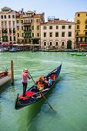
Illustration: Of Gondolas and Mazes
1. Venice is like a maze, signs appeal to strongest desire you have to go where you want. 2. Key points:
a. God designed/predestined everything in the maze, to include our free choices.
b. Our choices are according to our strongest desire at the moment. We always get what we want.
c. God works through means to ensure we turn where He wants us to in accordance w/His foreordained plans/purposes.
Notes:
c. Examples: to ensure we that obey the command to come to Christ, God first gives us a new heart and puts a new spirit within us to cause us to walk in His statutes (Ezek 36:26-27). If it is a sinful choice (such as denying Christ three times), He withholds His grace, brings circumstances into our lives that will ensure that the choice we make is consistent with His plans and purposes. And He can even use Satan to tempt that person by make a direct appeal to the sinners desires. So, the direct and immediate cause of my temptation is Satan, who appeals to my sinful desires, and God has ordained all of that to take place to fulfill His sovereign plan. God is not the author of the temptation, Satan is. And God is not the author of the sin, the individual is.

Slide 20
D. Unable to fully reconcile how God exercises control over our free, self-determined activities. Why?
1. God is God, and we are not.
2. Some key things to keep in mind:
a. God is sovereign, and we make choices we’re responsible for. Both truths held equally so as not to diminish who God is, and who man is.
b. Our choices and what we do matters intensely to God. We grieve Him when we don’t obey, and He lets us know that everything we do is meaningful.

Slide 21
IV. Practical Implications of God's Sovereignty
A. Reminds us that God is God, and we are not!
B. Reminds us that we are creatures who are totally dependent upon God for everything.
C. Is a source for comfort and hope and faith, because in it we discover that God is indeed directing all things—the good, and the bad—to an ultimately glorious end.

