Slide 1
Philippians:
Chapter 1

Slide 2
1 Paul and Timothy, servants of Christ Jesus, To all the saints in Christ Jesus who are at Philippi, with the overseers and deacons: 2 Grace to you and peace from God our Father and the Lord Jesus Christ. 3 I thank my God in all my remembrance of you, 4 always in every prayer of mine for you all making my prayer with joy, 5 because of your partnership in the gospel from the first day until now. 6 And I am sure of this, that he who began a good work in you will bring it to completion at the day of Jesus Christ. 7 It is right for me to feel this way about you all, because I hold you in my heart, for you are all partakers with me of grace, both in my imprisonment and in the defense and confirmation of the gospel. 8 For God is my witness, how I yearn for you all with the affection of Christ Jesus.

Slide 3
9 And it is my prayer that your love may abound more and more, with knowledge and all discernment, 10 so that you may approve what is excellent, and so be pure and blameless for the day of Christ, 11 filled with the fruit of righteousness that comes through Jesus Christ, to the glory and praise of God. 12 I want you to know, brothers, that what has happened to me has really served to advance the gospel, 13 so that it has become known throughout the whole imperial guard and to all the rest that my imprisonment is for Christ. 14 And most of the brothers, having become confident in the Lord by my imprisonment, are much more bold to speak the word without fear. 15 Some indeed preach Christ from envy and rivalry, but others from good will.

Slide 4
16 The latter do it out of love, knowing that I am put here for the defense of the gospel. 17 The former proclaim Christ out of selfish ambition, not sincerely but thinking to afflict me in my imprisonment. 18 What then? Only that in every way, whether in pretense or in truth, Christ is proclaimed, and in that I rejoice. Yes, and I will rejoice, 19 for I know that through your prayers and the help of the Spirit of Jesus Christ this will turn out for my deliverance, 20 as it is my eager expectation and hope that I will not be at all ashamed, but that with full courage now as always Christ will be honored in my body, whether by life or by death. 21 For to me to live is Christ, and to die is gain. 22 If I am to live in the flesh, that means fruitful labor for me. Yet which I shall choose I cannot tell.

Slide 5
23 I am hard pressed between the two. My desire is to depart and be with Christ, for that is far better. 24 But to remain in the flesh is more necessary on your account. 25 Convinced of this, I know that I will remain and continue with you all, for your progress and joy in the faith, 26 so that in me you may have ample cause to glory in Christ Jesus, because of my coming to you again. 27 Only let your manner of life be worthy of the gospel of Christ, so that whether I come and see you or am absent, I may hear of you that you are standing firm in one spirit, with one mind striving side by side for the faith of the gospel, 28 and not frightened in anything by your opponents. This is a clear sign to them of their destruction, but of your salvation, and that from God.

Slide 6
29 For it has been granted to you that for the sake of Christ you should not only believe in him but also suffer for his sake, 30 engaged in the same conflict that you saw I had and now hear that I still have.

Slide 7
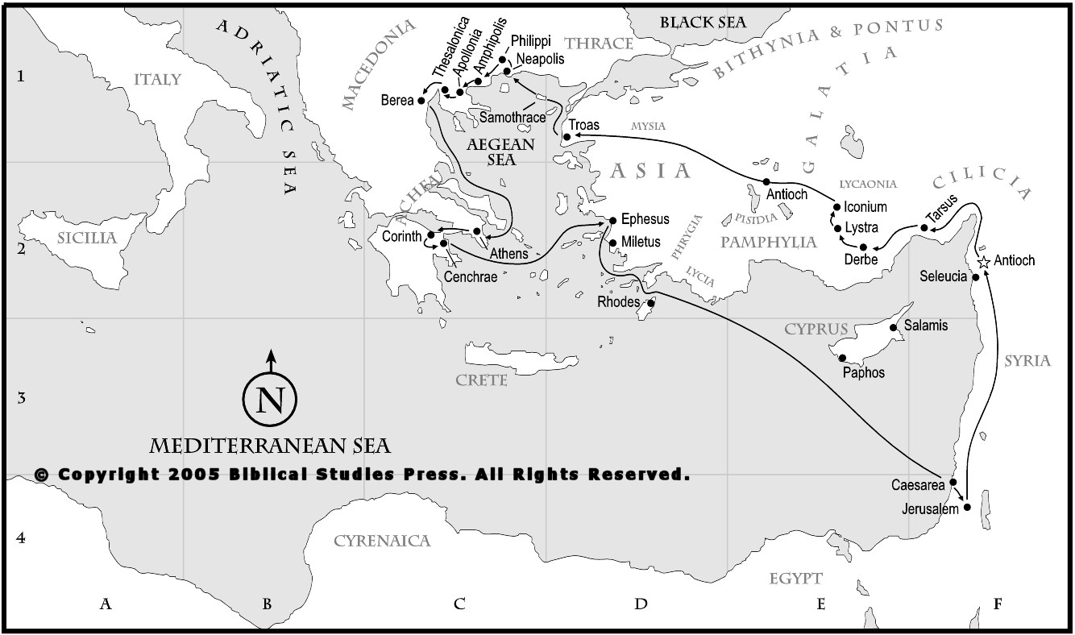
1. Author/date: Paul (& Timothy). 62AD, Roman prison.
2. Recipients: Church at Philippi: 1st church Paul plants in Europe (Acts 16:6-40), 2d missionary journey.
Notes:
2. 1st convert – Lydia. Paul and Silas imprisoned, conversion of Philippian Jailer

Slide 8
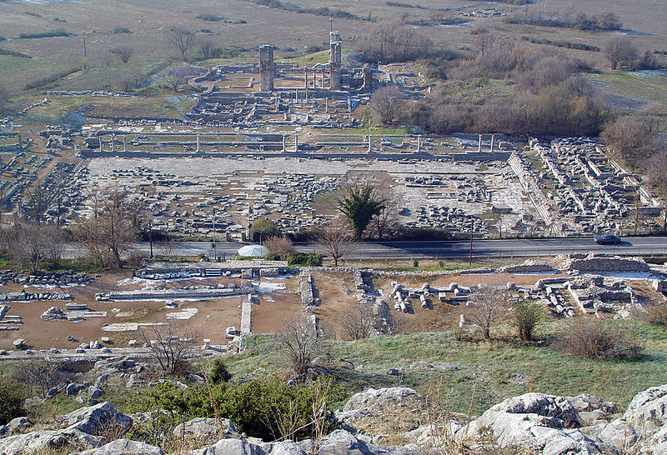
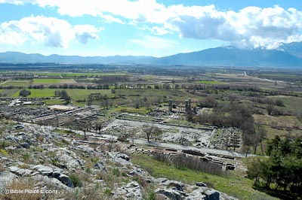
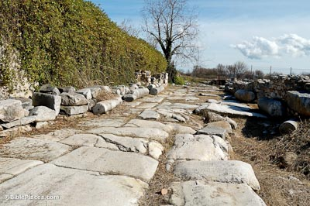
3. About Philippi: "Founded in the 4th c. B.C. and named after King Philip of Macedon, Philippi was an important outpost on the Egnation Way."*
Notes:
The Via Egnatia was built beginning in 145 BC and at its greatest extent connected Byzantium with the Adriatic ports. This route was Rome's primary artery to the east and Philippi was an important outpost along the road. The Egnatian Way made it easier for Rome to move troops throughout the empire and it was the route that Paul traveled on from Neapolis to Philippi, Amphipolis, Apollonia and Thessalonica.

Slide 9
4. Purpose: To encourage them to stand firm in the power, joy, and their unity in the Gospel by looking to Christ who is the purpose (chap 1), pattern (chap 2), prize (chap 3) and power (chap 4) of our lives.
5. Main Idea: "Our union with and unity in Christ are the basis for joyful, humble, service—no matter what the circumstances."*
6. Key Themes:
- Joy (20 times)
- Fellowship (partnership/participation)
- In Christ (9 times)
- Citizenship (strategically placed: 1:27; 3:20)

Slide 10
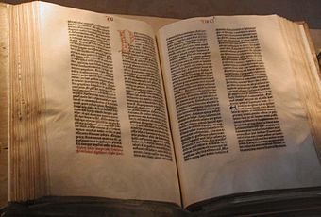
7. Basics of biblical interpretation:
A. Observation: what do I see— what does text say?
B. Focus on the obvious: Who, what, where, when, why, how? Fact gathering.
C. Interpretation: what does the text mean?
D. Application: how does the text apply to me IN CHRIST?

Slide 11
I. Greeting (vv. 1-2): 1 Paul and Timothy, servants of Christ Jesus, To all the saints in Christ Jesus who are at Philippi, with the overseers and deacons: 2 Grace to you and peace from God our Father and the Lord Jesus Christ.
A. How are Paul and Timothy described?
B. How are the Philippians described?
C. Significance of grace and peace? God our Father and the Lord Jesus Christ?
Notes:
- Timothy helped Paul establish church @ Philippi. Paul is the author, but Timothy is with him.
- Timothy mentioned more as being with Paul, not as a co-author.
A. How described: servants of Christ (Anointed King) Jesus. Servants of the king! That's how we should see ourselves!
B. Saints (holy ones) – emphasizes the objective work of God in saving them and their position (not necessarily practice) before God of right standing before God based on Christ's imputed righteousness. This comes out in next phrase: IN CHRIST. Emphasis: Union with Christ. Notice the 2 spheres the Philippians are in: they are IN Christ, and are AT Philippi. We are sojourners here. The earth is our temporary home. We're just passing through.
C. Overseers and deacons. Note the plurality of overseers (elders).
D. Grace and peace – emphasis on the Good News of the Gospel: saved by undeserved favor, so now we have peace w/God (both positionally) but we also have the peace of God—calmness of spirit and mind. This ebbs and flows, so we pray for that. And we pray for grace that we have, that it would increase more to nourish us and enable us to live for Christ.
E. Note the equality that is stressed between the Father and Christ. Alludes to full divinity of Jesus and Trinity.

Slide 12
II. Opening Remarks (vv. 3-11):
A. Paul's thanks for them: vv. 3-6 "3 I thank my God in all my remembrance of you, 4 always in every prayer of mine for you all making my prayer with joy, 5 because of your partnership in the gospel from the first day until now.
1. Why does Paul give thanks?
2. Discuss idea of partnership in Gospel.
Notes:
2. Partnership in the Gospel
-- What does partnership in Gospel mean?
-- Aspects of the Partnership (Ferguson):
1) Gospel centered: focused on proclaiming Gospel
2) Personal and Material to Paul (2:25; 4:14)
3) Ongoing – First day until now: They were saved by grace. That moment they were ambassadors of Christ and ministered. They kept running the race. Their support did not wane in support. How does this apply to us today?

Slide 13
B. Paul's confidence regarding them: vv. 6-8 – 6 And I am sure of this, that he who began a good work in you will bring it to completion at the day of Jesus Christ. 7 It is right for me to feel this way about you all, because I hold you in my heart, for you are all partakers with me of grace, both in my imprisonment and in the defense and confirmation of the gospel. 8 For God is my witness, how I yearn for you all with the affection of Christ Jesus.
1. Why is Paul confident?
2. Discuss v. 6
Notes:
2. Perseverance of the Saints Discuss v. 6: Who is "he"? What is the good work? Who began and completes the good work? What does this imply about the Gospel? When is it completed? What is the day of Christ?

Slide 14
WCF 17 – Of The Perseverance of the Saints
i. They, whom God hath accepted in his Beloved, effectually called, and sanctified by his Spirit, can neither totally nor finally fall away from the state of grace, but shall certainly persevere therein to the end, and be eternally saved.
ii. This perseverance of the saints depends not upon their own free will, but upon the immutability of the decree of election, flowing from the free and unchangeable love of God the Father; upon the efficacy of the merit and intercession of Jesus Christ, the abiding of the Spirit, and of the seed of God within them, and the nature of the covenant of grace: from all which ariseth also the certainty and infallibility thereof.
Notes:
2. Perseverance of the Saints Discuss v. 6: Who is "he"? What is the good work? Who began and completes the good work? What does this imply about the Gospel? When is it completed? What is the day of Christ?

Slide 15
3. 7 It is right for me to feel this way about you all, because I hold you in my heart, for you are all partakers with me of grace, both in my imprisonment and in the defense and confirmation of the gospel. 8 For God is my witness, how I yearn for you all with the affection of Christ Jesus.
a. Partakers of grace? How?
1) Imprisonment: by gifts they sent.
2) Defense/Confirmation of gospel.
b. Discuss v. 8
Notes:
3.a.1) Discuss how we help missionaries and church planters.
3a.2) These refer to Paul's activities in the prison: defense of the Gospel; and the result: confirmation (Greek: cause something to be known as certain) - of the Gospel. Paul attributes this to the help of the Philippians
3.b. In light of all of this, the Philippians are a model church in many ways. Paul can make no greater appeal than to God Himself.

Slide 16
C. Paul's prayer for them: vv. 9- 11 "9 And it is my prayer that your love may abound more and more, with knowledge and all discernment, 10 so that you may approve what is excellent, and so be pure and blameless for the day of Christ, 11 filled with the fruit of righteousness that comes through Jesus Christ, to the glory and praise of God."
1. Love abound? Knowledge/discernment?
2. Discuss vv. 10-11
Notes:
1. Love abound – need for their continued growth, and particularly in light of the divisions among them. Knowledge (of Christ/Gospel), Discernment (recognize the work of the evil one in their midst that would work against their love for one another and cause dissension among them).
2. Pure/blameless – not perfectly pure, but a life of habitual conformity to God's commands. This is further defined in v. 11 ' filled with fruit of righteousness. How does this fruit come? Through Jesus Christ. Discuss what this means practically for your life in Christ?
- For the day of Christ –We live in light of His return. Implications?
- The reasons for everything: To the glory and praise of God.
-- Note that we find by implication all 3 persons of Trinity: day of Christ (the Son); filled…through Jesus (implies Spirit); glory/praise of God (the Father).

Slide 17
III. The Advance of the Gospel
A. Paul's imprisonment: "12 I want you to know, brothers, that what has happened to me has really served to advance the gospel, 13 so that it has become known throughout the whole imperial guard and to all the rest that my imprisonment is for Christ. 14 And most of the brothers, having become confident in the Lord by my imprisonment, are much more bold to speak the word without fear.
- What effect did Paul's imprisonment have on the enemies of the Gospel? On believers? Discuss possible applications.

Slide 18
B. Motives for Preaching Christ: 15 Some indeed preach Christ from envy and rivalry, but others from good will. 16 The latter do it out of love, knowing that I am put here for the defense of the gospel. 17 The former proclaim Christ out of self ambition, not sincerely but thinking to afflict me in my imprisonment.
1. What motives does Paul identify?
2. Conclusion: 18 What then? Only that in every way, whether in pretense or in truth, Christ is proclaimed, and in that I rejoice.
Notes:
B.1. Discuss the power of motives:
a. Were those w/wrong motives preaching false gospel? No. Paul rejoiced that they preached Christ. So, we see the power of sin at work here. (see Matt 7:22)
b. Why did they envy/rivalry? Possibly b/c they saw the influence of Paul and wanted to usurp his authority, and also b/c they want to afflict him more. Why would this afflict Paul? Because not only would Paul be suffering physically in chains, but, they could break his spirit as Paul would witness diminished influence, all the while knowing that their motives were not to see Christ exalted, but to see Paul brought low.
c. Why does Paul mention this now about rivalry and envy? Possibly in light of the division that he had to address in Philippi (similar situation possibly).

Slide 19
IV. Paul's desire to come to them
A. 19 for I know that through your prayers and the help of the Spirit of Jesus Christ this will turn out for my deliverance, 20 as it is my eager expectation and hope that I will not be at all ashamed, but that with full courage now as always Christ will be honored in my body, whether by life or by death. 21 For to me to live is Christ, and to die is gain.
1. What does Paul's hope rest on?
2. Discuss v. 21
Notes:
A. Their prayers – Paul is recognizing his own need for the intercession of fellow believers. The Spirit of Christ – the Holy Spirit. Here you see God working through means of His people. Paul is basically saying he rests all of his hope on God.
B. “to live is Christ, and to die is gain.” Christ and Christ alone and His Gospel was the purpose of his life. Christ was the air that he breathed. To live is Christ means, as Paul says in 3:8, that we count everything as loss that we might know Him. It means as he says in 4:11 to be content regardless of the circumstances. So for Paul, whether he was in prison, or free, whether he would live or die, Christ was his life, and he wanted Christ to be magnified in him.

Slide 20
B. 22 If I am to live in the flesh, that means fruitful labor for me. Yet which I shall choose I cannot tell. 23 I am hard pressed between the two. My desire is to depart and be with Christ, for that is far better. 24 But to remain in the flesh is more necessary on your account. 25 Convinced of this, I know that I will remain and continue with you all, for your progress and joy in the faith, 26 so that in me you may have ample cause to glory in Christ Jesus, because of my coming to you again.
1. Discuss Paul's struggle.
2. How do we make decisions:

Slide 21
1. Kingdom first: is it clear which option better advances this?
a. Enable me to grow in Christ-likeness
b. Enable me to bear more fruit for Christ?
2. Communicating with God
a. God's Word: are there clear biblical guidelines that direct my decision.
b. Prayer: Ask God for wisdom and discernment
3. Common sense: does the decision reflect sound judgment?

Slide 22
4. Counsel from others: what do other godly people think?
5. Circumstances: How has God gifted me? Guided me? What are providential factors that help me decide?
6. Compulsion: what are my desire?
7. Contentment: do I have a sense of peace about the decision?
8. Confirmation: putting all factors together, is there more settled sense on what to do?

Slide 23
V. Concluding thoughts:
27 Only let your manner of life be worthy of the gospel of Christ, so that whether I come and see you or am absent, I may hear of you that you are standing firm in one spirit, with one mind striving side by side for the faith of the gospel, 28 and not frightened in anything by your opponents. This is a clear sign to them of their destruction, but of your salvation, and that from God. 29 For it has been granted to you that for the sake of Christ you should not only believe in him but also suffer for his sake, 30 engaged in the same conflict that you saw I had and now hear that I still have.
Notes:
vv. 27-30 Paul encourages them to live lives worthy of the Gospel and to not fear those that oppose them. How do we do this?
- v. 27 – live in manner worthy of Gospel: be who you are in Christ. How? Means of grace (Word, prayer, fellowship). Fellowship comes into sharp focus here: standing firm in one spirit, with one mind striving side by side for the faith of the gospel.
-- Christ and His Gospel is our purpose for living, and the pursuit of that purpose doesn’t happen in isolation, but only in community with other believers who are striving side by side for the faith of the Gospel!
- v. 29 "For" - Granted to us to believe…and suffer for this cause. Sovereignty of God in our salvation and circumstances stressed.

