Slide 1
Who Is Man Pt 2:
God's Covenants with Man

Slide 2
Brief Review:
1. Man was created as God's image bearer.
2. Man had the ability, prior to the fall, to reflect God’s character in thought, word and deed, and was to be God's representative on earth.
3. But man sinned against God.
4. The image was defaced, but not erased.
5. God is at work in believers, restoring this image in knowledge, righteousness, and holiness.
Notes:
WSC 13 - Our first parents, being left to the freedom of their own will, fell from the estate wherein they were created, by sinning against God.. WSC 14: Sin is any want of conformity unto, or transgression of the law of God.
2. Sin is “…the rejection of God–a repudiation of God’s rule, God’s care, God’s authority, and God’s right to command...It is the rebellion of the creature against his Creator.” – Greg Gilbert

Slide 3
WCF 7.1 - The distance between God and the creature is so great, that although reasonable creatures do owe obedience unto him as their Creator, yet they could never have any fruition of him as their blessedness and reward, but by some voluntary condescension on God's part, which he hath been pleased to express by way of covenant.

Slide 4
Covenantal Framework of Scripture
1. Covenant is organizing principle: “the covenant…is the very fabric of Scripture. It is God’s chosen framework for the Bible.” – Brown/Keele
2. Covenant Theology (CT): an interpretive framework for understanding what God has done in history to redeem a people for Himself through the bible’s own organizing principle of the covenant.
3. Scriptures Storyline: Creation, Fall, Redemption, Consummation: CT shows how the story progresses in a unified way from Gen-Rev by way of covenants.

Slide 5
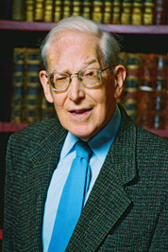
I. Definition of covenant:
A. “Solemn agreements, negotiated or unilaterally imposed, that bind the parties to each other in permanent defined relationships, with specific promises, claims, and obligations on both sides." – J.I. Packer. * Examples from everyday life?
B. "God's purpose in history is to govern his kingdom of creation and bring forth His holy kingdom. His covenants, therefore, are the way that God administers His kingdom." Brown and Keele
Notes:
I.A. Refined definition of biblical covenants (borrowing/mixing from Packer and Grudem): Divinely imposed legal agreement that binds God and man in a permanent relationship with specific promises and obligations on both sides. "It is always made clear that the initiative is God's - that He makes covenants with his people and not vice versa. God initiates, confirms and even fulfills (ultimately in Christ, both sides of) the covenant."
I.A. Examples: Marriage, adoption, treaties, loans, etc.

Slide 6
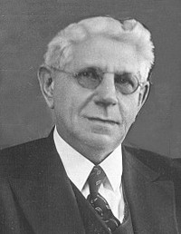
II. Where did the concept of covenant come from?
A. The Triune God is covenantal:
"…the archetype of all covenant life is found
in the Trinitarian being of God, and what is
seen among men is but a faint copy of this."
B. Man reflects as image bearer of God.
III. Key elements contained in covenants:
A. Identification of the parties involved
B. Stipulations: Legally binding conditions.
C. Promises: marked w/covenant signs.
Notes:
II.A. Archetype = "the original pattern or model from which all things of the same kind are copied or…based."
III. The Suzerain-vassal Treaty was a covenant made between a great king and one his subject kings. The Great king demanded absolute loyalty (the vassal must “love” his suzerain), and offered complete protection. This form of covenant included the following formal elements:
1. Preamble –Identified the Great King. “I am the LORD your God” – Deut. 5:6; Ex. 20:1-2.
2. Historical Prologue – What the Great King had done for the vassals. “I am the LORD your God, who brought you out of Egypt, out of the land of slavery.” – Deut. 5:6; Joshua 23: 9-10.
3. Stipulations - The Great King’s rules and requirements, example: 10 cmmandments.
4. Sanctions – This spells out the benefits for those who keep the treaty, and punishments for those who do not keep the treaty. Ancient Near Eastern kings usually evicted and exiled treaty breakers. (Deut. 5:32-33; 6:24-25; 7:9-11; Joshua 23:12-13).
5. Deposit of Treaty/Public reading/Ceremony and sealing – Both parties kept a copy of the treaty in their sacred temples (so the gods could keep a constant witness), and vassals were required to publicly and regularly read the treaty so that succeeding generations understood their obligations. The treaty would be ratified in public ceremony that might include public signs or seals as reminders. (Exodus 24:1-8; Deut. 6:6-9, 20-25; Joshua 24:16-27).
III. C. Calvin said that a sacrament “is an external sign, by which the Lord seals on our consciences his promises of good will toward us, in order to sustain the weakness of our faith, and we in turn testify our piety towards him, both before himself and before…men”
III.

Slide 7
IV. The overarching categories of covenants:
*Covenant of Redemption *Covenant of Works *Covenant of Grace
A. These are theological categories.
B. Phrases not in Scripture. So, why use them?
1. Help explain truth of Scripture. Examples?
- Trinity, incarnation, sin/fall in Gen 3.
2. A word/phrase does not have to appear in text if it accurately captures what the text teaches.
Notes:
II.A.1. Examples: Trinity, Total Depravity, Limited Atonement, Irresistible Grace, The Lord’s Prayer, The incarnation, etc., etc. Covenant of works: word covenant not found in Genesis 2-3, but concept is. Also, note, neither is the word “fall” and neither is the word “sin.” Yet we use the those words to describe the situation taught in there

Slide 8
Covenant of Redemption (Pactum Salutis)
I. Definition: “..established in eternity between the Father, who gives the Son to be the Redeemer of the elect and requires of Him the conditions for their redemption, and the Son, who voluntarily
agrees to fulfill these conditions, and the Spirit, who voluntarily applies the work of the Son to the elect.” Brown
II. Key Texts: John 17:1-2ff – “…"Father, the hour has come; glorify your Son that the Son may glorify you, since you have given him authority over all flesh, to give eternal life to all whom you have given him…"
-- See also Psa 2:7-8; Isa 40:6-8; Isa 53:10-12; Eph 1:3-14
Notes:
I. Definition: God’s blueprint for redemption (and all history). All other covenants flow from this one. “God’s plan for our salvation was not only a concept but also an actual covenant between the persons of the Trinity.”
Ps 2:7-8 The Father makes an oath to the Son, whom he would anoint as the Messiah-King that He would give Him the nations. This is conditioned on the Son obeying the stipulations of the covenant.
Is 40:6-8 (Heb 10:5-9): Christ’s royal words as He submitted to the Father in the covenant of Redemption.
Isa 53: Relationship b/t Father and the Servant (Son) concerning redemption of sinners is couched in covenantal terms—Term “my servant” is classic covenant language. There is language of obedience and reward: will see travail of His soul and be satisfied. Through active obedience of Christ many will be justified. These are His “offspring.”
Eph 1 - All 3 persons of Godhead seen. Father chooses IN Christ. Son redeems. Spirit applies, seals, guarantee.

Slide 9
Covenant of Works
I. WCF 7.2 "The first covenant made with man was a covenant of works, wherein life was promised to Adam; and in him to his posterity, upon condition of perfect and personal obedience."
II. “God’s commitment to give Adam, and his posterity in him, eternal life for obedience, or eternal death for disobedience.” Brown and Keele
III. Word “covenant” not used, so how a covenant?

Slide 10
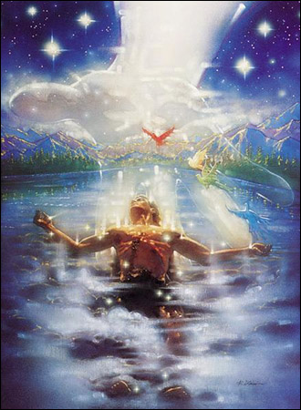
A. Image of God entails being in covenant w/God
*Adam: prophet (word), priest (worship/service to God), king (rule).
B. Covenantal language in Gen 2-3
1. Parties id'd: LORD (covenant name)/Adam.
2. Legally binding conditions:
a) Keep/guard (shamar – Gen 2:15)
b) Dominion: Fruitful/multiply
Notes:
A. Prophet: Notice the confusion over the Word of God between Eve and the Serpent. Adam was rebuked by God for listening to Eve—He failed in his role as a prophet—a guardian and proclaimer of God's Word.
B.2.a) Priestly function of guarding Garden "temple": : same role as Levites. keep unclean out of temple, etc.—Adam must guard against any intruder and get rid of it—crush serpents head; and cultivate (priestly task).
B.2.b) Dominion: cultural mandate, kingly function.

Slide 11
3. Promises: Trees offer reward of blessing for perfect, personal, perpetual obedience, or cursing.
a) Trees of life = prospect of glorified life
b) Tree of knowledge of good/evil: death.
c) Adam covenant head:
* Obeys = life for him and those in him. * Disobeys: curse for him and those in him.
IV. Key Texts: Gen 2-3; Isa 24:5; Hos 6:7; Rom 5:12-19
Rom 5:19 "For as by the one man's disobedience the many were made sinners, so by the one man's obedience the many will be made righteous."
Notes:
3.a) Tree of life: does not symbolize mere life, but glorified life: the inability to sin, etc. (Rev 2:7; 22:14)
3.c) Probation: The testing would come through Satan. If Adam passes test, at that point inherits eschatological life (Rev 22), confirmed in righteousness, but not glorified until dominion mandate fulfilled. Christ succeeds where Adam failed. Dominion mandate is being accomplished through Christ—those confirmed in righteousness but not glorified. When completed, brought into glory.
Isaiah 24:5 “The earth lies defiled under its inhabitants; for they have transgressed the laws, violated the statutes, broken the everlasting covenant.” – Isaiah refers to humanity. Didn’t have law of Moses or the covenants of Israel. They were in, in Adam and stand under CoW.
Hosea 6:7 “ But like Adam they transgressed the covenant; there they dealt faithlessly with me.” Brown and Keele “The prophet here is actually making a play off of Adam. He is pointing to two entities name Adam: the man Adam, and a town named Adam.
Rom 5:12-19 Two Adams. Federal heads. Christ is covenant head of His people. If true of Him, true of Adam. V. 13 - v. 13, Lig Duncan: “…Paul says universal sin demonstrates universal guilt. Universal sin demonstrates universal law. Paul says here that there was sin in the world before the giving of Moses’ law. And so there must have been a law to break. You can’t sin, you can’t transgress unless there is something to transgress.

Slide 12
Covenant of Grace
WCF 7.3. Man, by his fall, having made himself incapable of life by that covenant, the Lord was pleased to make a second, commonly called the covenant of grace; wherein he freely offereth unto sinners life and salvation by Jesus Christ; requiring of them faith in him, that they may be saved, and promising to give unto all those that are ordained unto eternal life his Holy Spirit, to make them willing, and able to believe.

Slide 13
I. Definition: a covenant between God and believers with their children in which He promises salvation through faith in Christ, who merited their salvation by His obedience in the covenant of redemption.
A. An outworking of covenant of redemption.
B. It is a covenant of works for Jesus.
C. Key texts:
1. Gen 3:15 “I will put enmity between you and the woman, and between your offspring and her offspring; he shall bruise your head, and you shall bruise his heel."
Notes:
Covenant of grace filled up in Abraham, God’s primary revelation of CoG: Land, seed, great nation. Two stage/level fulfillment: Israel – offspring = numerous descendants; land = Canann during old (Mosaic Covenant), Christ – offspring = church; land = new heavens and new earth during new covenant.

Slide 14
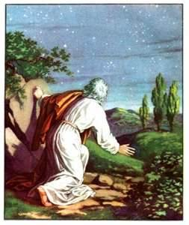
2. Gen 12; 15; 17 – Covenant w/Abraham:
a) CoG filled up in Abraham/God's primary revelation of the CoG.
b) Promises: Land, seed, great nation. Two stages of fulfillment:
i) Israel: offspring (numerous physical descendants); land (Canaan during Mosaic Covenant); great nation (Davidic dynasty)
ii) Christ: offspring (numerous spiritual descendants); land (new heavens/earth); Great Nation (Christ's Kingdom)
Notes:
Gen 12:2-3 - I will make of you a great nation, and I will bless you and make your name great, so that you will be a blessing. Gen 12:3 I will bless those who bless you, and him who dishonors you I will curse, and in you all the families of the earth shall be blessed."
Gen 15:5 And he brought him outside and said, "Look toward heaven, and number the stars, if you are able to number them." Then he said to him, "So shall your offspring be." Gen 15:6 And he believed the LORD, and he counted it to him as righteousness.
Gen 17:4 "Behold, my covenant is with you, and you shall be the father of a multitude of nations. Gen 17:5 No longer shall your name be called Abram, but your name shall be Abraham, for I have made you the father of a multitude of nations. Gen 17:6 I will make you exceedingly fruitful, and I will make you into nations, and kings shall come from you.
Gen 17:7 And I will establish my covenant between me and you and your offspring after you throughout their generations for an everlasting covenant, to be God to you and to your offspring after you. Gen 17:8 And I will give to you and to your offspring after you the land of your sojournings, all the land of Canaan, for an everlasting possession, and I will be their God."

Slide 15
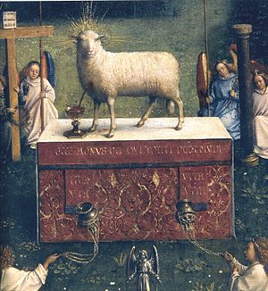
II. Different Administrations: All subsequent covenants fall under this one overarching covenant of grace. Only one way of salvation after the fall: grace alone through faith alone by Christ alone.
A. Under the Law: "administered by promises, prophecies, sacrifices, circumcision, the passover lamb…all foresignifying Christ to come; which were, for that time, sufficient and efficacious, through the operation of the
Spirit, to instruct and build up the elect in faith in the promised Messiah, by whom they had full remission of sins, and eternal salvation; and is called the old testament"
Notes:
Unlike Adam’s disobedience in Eden that led to exile from God’s presence, Israel must obey in their ‘Eden’ to fulfill their renewed commission as a corporate Adam. However Israel sinned like Adam and was exiled from God’s presence and out of the land, and god withdrew his presence from their temple. As a result, the prophecies and promises for God’s people to be fruitful and multiply and fill the earth, exanpding the sanctuary of Eden, are neither fulfilled in the line of Abraham in the Old Testament nor in Israel’s temple. How will these promises be realized and our mission fulfilled? We must turn to the work of Jesus, the second Adam and new Israel, to answer this question.” -- Beale and Kim, God Dwells Among Us: Expanding Eden to the Ends of the Earth

Slide 16
B. Under the gospel: "when Christ, the substance, was exhibited, the ordinances in which this covenant is dispensed are the preaching of the Word, and the administration of the sacraments of baptism and the Lord's Supper: which, though fewer in number, and administered with more simplicity, and less outward glory, yet, in them, it is held forth in more fullness, evidence and spiritual efficacy, to all nations…and is called the new testament."
Conclusion: "There are not therefore two covenants of grace, differing in substance, but one and the same, under various dispensations."

Slide 17
 | Covenant of Redemption | Covenant of Works | Covenant of Grace
Parties | Trinity | God and Adam | God and believers and their children
Stipulations | Elect to salvation, accomplish/apply salvation | Perfect obedience | Faith in Christ the Mediator.
Promise | Kingdom? | Eternal life | Eternal life

Slide 18
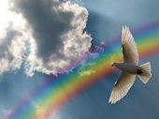
III. Major biblical covenants (definitions: Brown/Keele):
A. Noahic: God's covenant of common grace with the earth, despite man's depravity, to sustain its order until the consummation.
B. Abrahamic: God's covenant of grace established with Abraham and his offspring, wherein He promised the entire future of his covenantal kingdom, in both its old covenant and new covenant stages.

Slide 19
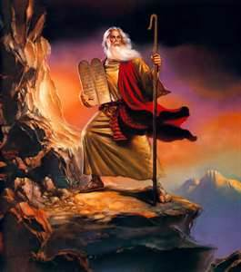
C. Mosaic: God's law covenant with Israel, wherein He graciously leads them to Christ by showing them the perfect righteousness that only Christ could fulfill to redeem sinners.
D. Davidic: God’s promise to David of an eternal kingdom.
E. New: : “God bringing forth the new creation in His people though the finished work of Christ, in fulfillment of the Abrahamic covenant.”
Notes:
New Covenant: New in relation to Mosaic covenant, not Abrahamic. Believers called offspring of Abraham.

