Slide 1
Iron Works Foundations

Slide 2
Who Is God?
Part 1:
God's Being and Attributes

Slide 3
Introduction
The Gospel: God, Man, Christ, Response
We will examine the:
The Being and Attributes of God (WSC 4-6)
The Decrees and Works of God (WSC 7-9, 11)

Slide 4
WSC 4. What is God?
A. God is a Spirit, infinite, eternal, and unchangeable, in his being, wisdom, power, holiness, justice, goodness, and truth.
WSC 5. Are there more Gods than one?
A. There is but one only, the living and true God.
WSC 6. How many persons are there in the godhead?
A. There are three persons in the Godhead; the Father, the Son, and the Holy Ghost; and these three are one God, the same in substance, equal in power and glory.

Slide 5
Key Verse
1 Tim 6:16: "[God] who is the blessed and only Sovereign, the King of kings and Lord of lords, who alone has immortality, who dwells in unapproachable light, whom no one has ever seen or can see. To him be honor and eternal dominion. Amen."

Slide 6
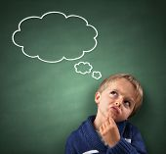
Our Limitations
1. The incomprehensibility of God: As finite
creatures we can never have exhaustive
knowledge of the infinite God.
Rom 11:28 Oh, the depth of the riches and wisdom and knowledge of God! How unsearchable are his judgments and how inscrutable his ways!
2. WCF 7.1 The distance between God and the creature is so great...[we] could never have any fruition of him as [our] blessedness and reward, but by some voluntary condescension on God's part…
Notes:
Distance in being is great.
Condescension: stooping down
Calvin, God accommodates the knowledge of himself "to our slight capacity. To do this he must descend far beneath his loftiness." (example: a nurse talking baby talk to an infant).

Slide 7
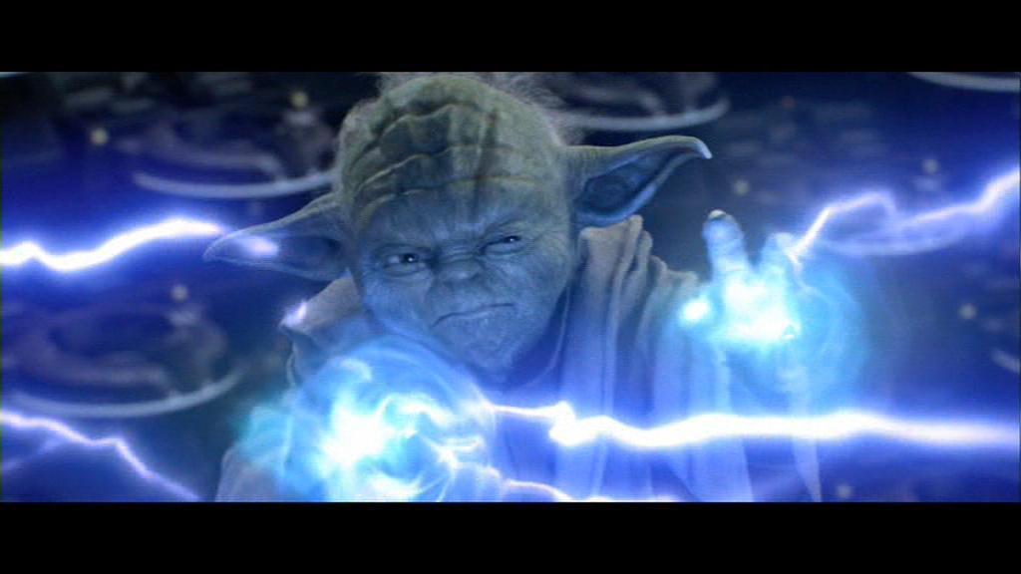
I. God's Being:
A. God is Spirit (John 4:24): God is pure being, no physical body/limitations, is invisible.
1 Tim 1:17 To the King of the ages, immortal, invisible, the only God, be honor and glory forever and ever. Amen.
B. God is Personal: God is not
a mere force, but is a rational/relational
being (Gen 1; John 17).
- Discuss implications for creation?
Notes:
A. John 4:24 – No one place prescribed as center for worship.
“In spirit” means “from a heart renewed by the Holy Spirit.” This makes it authentic
“In truth” means “on the basis of God’s Word and salvation in Christ our Mediator
B. An impersonal force cannot bring about order, design, purpose, and complexity. These all presuppose intelligence.

Slide 8
C. God is Perfect: No defects:
Deut 32:4 "The Rock, his work is perfect, for all his ways are justice. A God of faithfulness and without iniquity, just and upright is he."
1Jn 1:5 This is the message we have heard from him and proclaim to you, that God is light, and in him is no darkness at all.

Slide 9
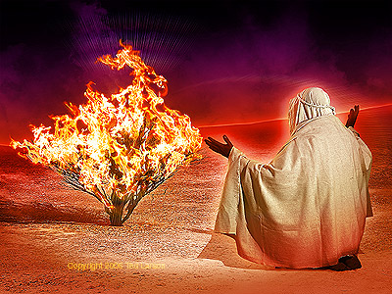
D. The Aseity (independence) of God: From Latin a sei (from oneself). God's being is not derived from or sustained by anything outside of Himself. He is completely self-existent, self-sufficient, self-fulfilled.
1. Exodus 3:14 - God said to Moses,
"I AM WHO I AM." And he said, "Say
this to the people of Israel, 'I AM has
sent me to you.'"
J.I. Packer: The [burning] bush, we
might say, was God’s three-dimensional illustration of His own inexhaustible life.”
Notes:
God is pure being, not becoming. He IS.
Significance of the Name (what does the name say about God)?
A. Answers the question “In what way does God exist?” “…proclaims his eternal, self-sustaining, self-determining, sovereign reality—that supernatural mode of existence that the sign of the burning bush had signified.

Slide 10
2. Acts 17:24-25 - “…24 The God who made the world and everything in it…does not live in temples made by man, 25 nor is he served by human hands, as though he needed anything..."
K. Scott Oliphint: "The aseity of God therefore must be the place on which we stand in order to assert anything else about him, given that anything else we say about him depends for its proper understanding and meaning on that aseity
…A god who is not "a se," and thus who is essentially dependent, is a god who is unable to be god..."
E. God is 1 in essence, 3 in person (Dt 6:4; Matt 3:16-17).

Slide 11
II. God's Attributes – Definitions/Distinctions:
A. God's Attributes: The infinite perfections of God's being.
B. God's Simplicity: God is not composed of parts. God is a unity, not a collection of attributes. Each attribute describes all of God's being.
C. Incommunicable: Attributes God does not share, or “communicate” to others. Emphasizes the absolute distinction between Creator/creature.
D. Communicable – Attributes God shares or “communicates” with us (yet, not in their fullness)
Notes:
Qualification: No attribute of God is completely communicable/incommunicable.
Examples: communicable: we have knowledge, but we will never be all knowing.
Incommunicable attributes - God is eternal, while we are subject to the limitations of time. We will live enjoy eternal life.

Slide 12
Indepen-
dent
Infinite
Eternal
God in His whole being is fully and always: Holy, Love, Infinite,
Independent,
Immutable
Immut-
able
Love
GOD
Good
Just
Holy
Wisdom
Wrong view of God and His attributes
Correct view of God and His attributes
Notes:
God's attributes are not additions to his being

Slide 13
E. Transcendence & Immanence
1. Transcendence = beyond/distinct from creation.
2. Immanence = presence/works within creation.
3. Is God transcendent, or immanent?
a) YES! But…Creator/Creature distinction.
b) Where most clearly seen?
John 1:1-3;14 – 1 In the beginning was the Word, and the Word was with God, and the Word was God. 2 He was in the beginning with God. 3 All things were made through him, and without him was not any thing made that was made…14 And the Word became flesh and dwelt among us...

Slide 14
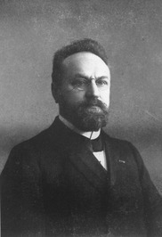
"It is a mark of God's greatness that he can condescend to the level of his creatures and that, though transcendent, he can dwell immanently in all created beings. Without losing himself, God can give himself, and, while absolutely maintaining
his immutability, he can enter into an infinite number of relations to his creatures." – Herman Bavinck
Notes:
Reformed Dogmatics, Vol 2, p. 159

Slide 15
Incommunicable Attributes
God in His being is:
A. Infinite: not subject to limitations (1 Kg 8:27) and is unlimited in all of His attributes. Examples:
1. Omnipresent: everywhere present (Ps 139:7-10)
2. Omniscient: all knowing (Job 37:16)
3. Omnipotent: all powerful (Job 42:2)
B. Eternal: No beginning, end (Ps 90:2), succession of moments in being. Sees all time equally vividly, yet acts in time.
1. Discuss: who made God? How might you prove?
Notes:
A.3. Omnipotence: not that He can do everything (He cannot sin, deny Himself, or make a square circle (irrationality), but means that He is able by the mere exercise of His will to accomplish all His purposes, and even more than that if He so desired.
B. How might you prove: a) it's what God declares of Himself; b) we know this innately as created in His image; c) the impossibility of the contrary; d) Something is eternal: God, or matter. Why? Because something exists now, and you can't get something out of nothing, and matter is wearing out. e) traditional arguments for God's existence: each one flawed at some point, and do not get us to God of Bible, but taken collectively are powerful.
Cosmology: Argument from creation and First Cause: if there is a creation, must be a creator. If something now, something has always existed. Can't get something from nothing.
Teleological: Argument from design. No one stumbles upon a watch and presupposes it just came together apart from intentional design from intelligent creature.
Moral argument: for justice, must survive grave. Must have being on other side who is omniscient: knows all facts of case; holy (not given corruption/can't bribe); just; omnipotent (powerful enough to exact the sentence.

Slide 16
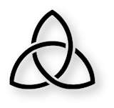
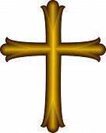
2. God sees all time equally vividly. He stands above time and sees it all as present in his consciousness.
∞
Creation Life of Christ
2015 Final Judgment
Notes:
Grudem

Slide 17
C. Unchangeable: "God is unchanging in his being, perfections, purposes, and promises…" – Grudem
Ps 102:26-27 – "[the earth and the heavens] will perish…but you are the same, and your years have no end." (Heb 1:11-12; 13:8). See also Mal 3:6; Ja 1:17
1. Discuss implications of this:
- Maintains Creator/creature distinction: God is not subject to change as creatures are (2 Pet. 3:8).
- Guarantees constancy of His being, perfections, promises, plans (Num. 23:19; Ps. 33:11)
Notes:
Creator/Creature distinction: God is being, we are becoming.

Slide 18
2. "…yet God does act and feel emotions, and he acts and feels differently in response to different situations."
Notes:
C. 2. In space and time, God has decreed to respond meaningfully to His creatures. When people change their attitude to him, he changes his attitude to them (Gen. 6:5-7; Jon. 3:10), which He ordained to do before time began. There is no change then from the perspective of His secret will of decree, but only in terms of his interaction based on what he revealed to creatures and their response. So, God can give conditions, which if met, would bring blessing, and if not met, judgment. These are not a change in God's being, or eternal plans or purposes.
Because His is infinite (and unchangeable in His attributes) he always acts the same toward moral evil (grief, judgment) and moral good (rejoice, reward). He feels emotion toward those who suffer. Christ helps us understand this more. (no change in the divine being in the incarnation—humanity simply added.

Slide 19
Immortal, invisible, God only wise, In light inaccessible hid from our eyes, Most blessed, most glorious, the Ancient of Days, Almighty, victorious, thy great Name we praise. Unresting, unhasting, and silent as light, Nor wanting, nor wasting, thou rulest in might; Thy justice like mountains high soaring above Thy clouds which are fountains of goodness and love.

Slide 20
Great Father of Glory, pure Father of Light, Thine angels adore thee, all veiling their sight; All praise we would render; O help us to see 'Tis only the splendor of light hideth thee!

